Slide 1

Crafting & Compelling Website Analysis, Audit and Recommendations
Project Title:
tcs
TATA CONSULTANCY SERVICE

Slide 2
ABOUT US:
TCS is a global leader in IT services, consulting, and business solutions, partnering with clients to transform their businesses through technology, innovation, and expertise.Tata Consultancy Services was founded in1968 by J.R.D. Tata. Its headquarters is located inMumbai, Maharashtra,India.
It service: A. Banking and Financial Services
B.Healthcare and Life Sciences
C. Retail and Consumer Goods

Slide 3
D.Manufacturing and Automotive E.Energy and Utilities F.Communications and Media
Global Presence: Presence in 150+ countries 500,000+ employees worldwide...
Innovation and R&D: TCS Innovation Labs for research and development Focus on emerging technologies like AI, blockchain, and cloud...
Corporate Philosophy:"Building on Belief"
Growth and Expansion: Expansion into new markets and industries...

Slide 4
Product and Service Descriptions:
TCS HOBS™
DESCRIPTION:
Comprehensive hotel management system for front-office, back-office, and point-of-sale operations, streamlining hotel operations and enhancing guest experiences.

Slide 5
2.TCS iON:
DESCRIPTION:
Cloud-based digital learning platform for education, corporate & government sectors, offering LMS, content library, assessment tools & analytics.

Slide 6
3.TCS BaNCS:
DESCRIPTION:
A comprehensive banking and financial services platform for core banking, payments, treasury, and insurance, enabling digital transformation and improved customer experiences.

Slide 7
3.Website Platform Identification:
TCS, a global leader in IT services, consulting, and business solutions, leverages technology for business transformation and helps catalyze change.

Slide 8
Content Management Systems (CMS):wordpress etc...
Web Development Framework: Spring,Django etc....
Cloud Platforms: Amazon Web Services (AWS)Google Cloud Platform (GCP) etc...
Design Tools: Adobe Sketch Figma etc...
Development Tools: Eclipse,Visual Studio etc..
Testing Tools: Selenium, Appium etc...

Slide 9
4. Responsive Design Testing:
RESPONSIVE DESIGN REPORT:
WEBSITE: https://www.tcs.com
TOOL:PAGE SPEED INSIGTS WEB DEVELOPER.
HOME PAGE: (Largest Contentful Paint (LCP), Interaction to Next Paint (INP), First Contentful Paint (FCP) ).

Slide 10
AI PAGE:(First Contentful Paint (FCP), Minimize main-thread work, Eliminate render-blocking resources ).
SOFTWARE PAGE: SOFTWARE PAGE: (Cumulative Layout Shift (CLS), Avoid large layout shifts,Efficiently encode images ).
ECOSYSTEM PAGE: ECOSYSTEM PAGE: (Minimize main-thread work, Eliminate render-blocking resources ).
CLOUD SERVICES PAGE:(Time to First Byte (TTFB), Reduce the impact of third-party code, Avoid an excessive DOM size ).

Slide 11
5. Website Mistakes Identification:
1. Cluttered and Confusing Layouts:
Overwhelming mix of content, images, and navigation that hinders website usability.
2. Slow Loading Times:
Slow loading times hurt user experience and SEO, impacting all content including videos and photos.

Slide 12
3. Mobile Responsiveness Issues:
A non-mobile-friendly site can frustrateusers and harm conversions.
4. Poor Navigation/Usability:
A confusing site structure can lead to high bounce rates and low engagement.

Slide 13
5.Lack of Clear Branding:
Confusion among customers
Difficulty differentiating from competitors
Inconsistent messaging and visual identity
Weak brand recognition and loyalty
Missed business opportunities
Decreased customer trust and credibility

Slide 14
6. Best Practices List:
Consistent Branding: Ensure consistent use of logos, colors, and typography across the website.
Simple Navigation: Use intuitive and simple navigation menus.
High-Quality Images: Use high-resolution images that are optimized for web use.

Slide 15
Typography: Use clear, readable fonts and consistent font sizes.
Responsive Design: Ensure the website is optimized for various devices and screen sizes.
Fast Loading Times: Optimize images and code to ensure fast loading times.
Color Scheme: Select a color scheme that aligns with the brand and is visually appealing.

Slide 16
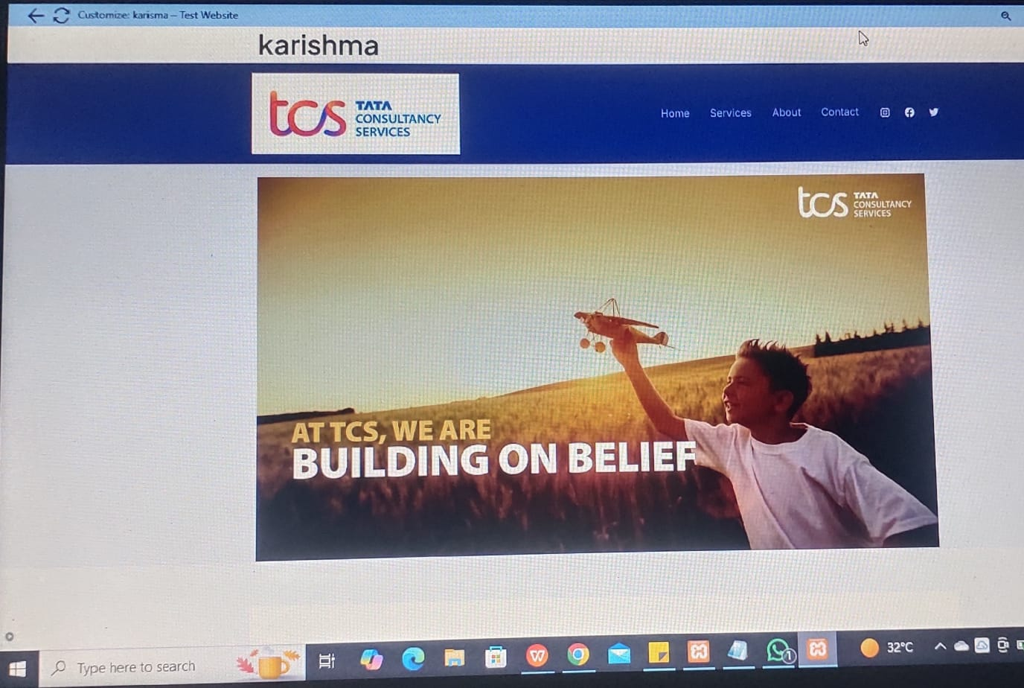
7. Website Design:
websitelink:http://localhost/web/karishma

Slide 17
THE END

